Slide 1
Developing Custom Visuals for Power BI
Notes:
This module examines developing custom visuals for Power BI and walks through setting up a development environment with Node.js and Visual Studio Code. The module introduces students to the Power BI Visuals API and explains the differences between custom visual projects that are created with version 2 versus version 3 of the Power BI Developer Tools (PBIVIZ). Students will learn how to define the capabilities and data mappings for a custom visual and how to program D3-style data binding using categorical data from a Power BI dataset. The module demonstrates how to extend a visual with custom properties as well as how to take advantage of the powerful utility classes that are included along with the Power BI Visuals API. The module demonstrates how to package a custom visual as a PBIVIZ file for distribution and demonstrates adding custom visuals to Power BI Desktop projects and publishing custom visuals to an organization.

Slide 2
Agenda
Installing the Power BI Developer Tools
Creating Your First Custom Visual
Defining Data Roles and Data Mappings
Extending a Visual with Custom Properties
Migrating to Version 3 of the Power BI Developer Tools

Slide 3
Installing the Power BI Developer Toolchain
Install Node.JS
Installs Node Package Manage (npm)
Install Visual Studio Code
Lightweight Alternative to Visual Studio for Node.js Development
Install the Power BI Developer Tools (pbiviz)
Install using Node Package Manager (npm)
Create and install a local self-signed certificate
Install using Power BI visuals CLI tool (pbiviz)

Slide 4
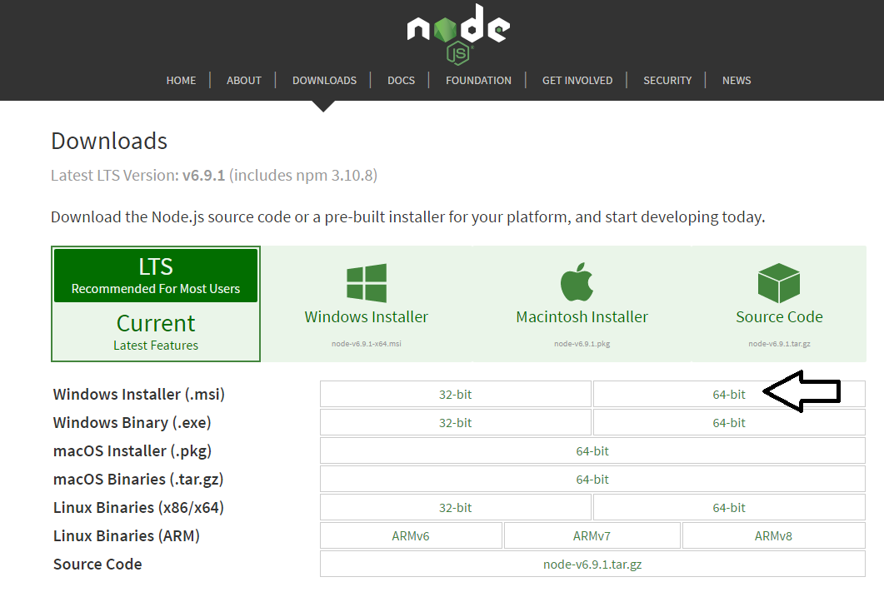
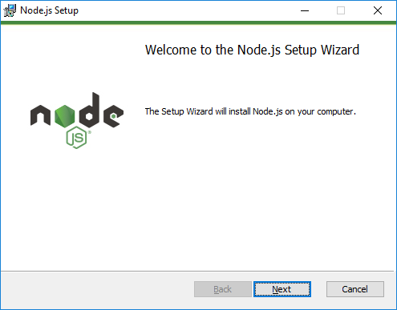
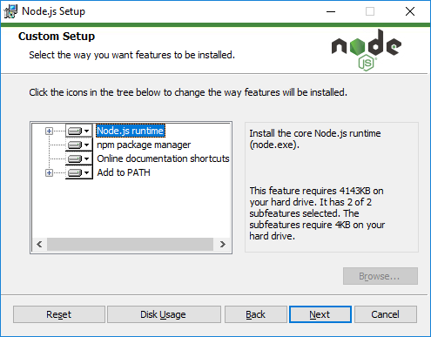
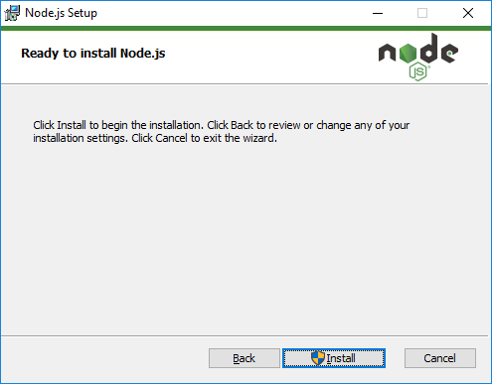
Installing node.js
https://nodejs.org/en/download/

Slide 5
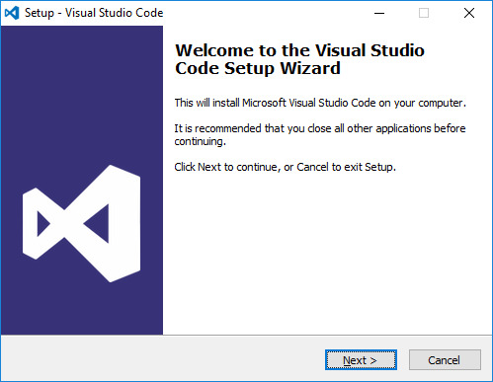
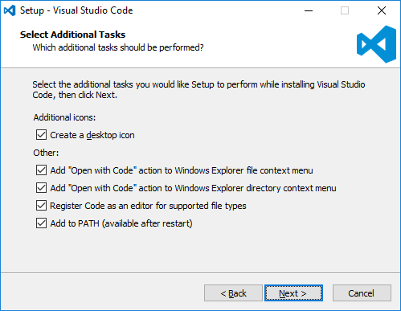
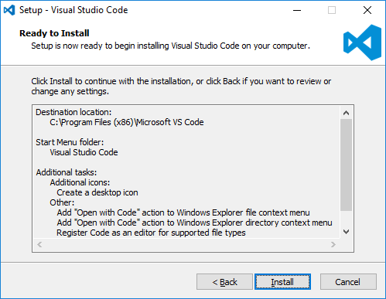
Install Visual Studio Code
http://code.visualstudio.com/

Slide 6
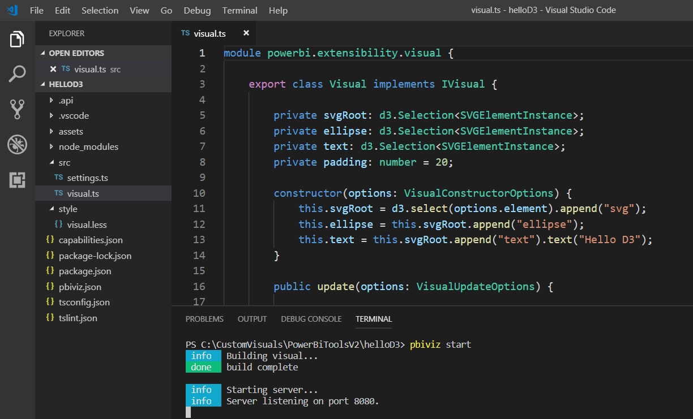
Developing with Visual Studio Code
Provides great development experience with node.js

Slide 7
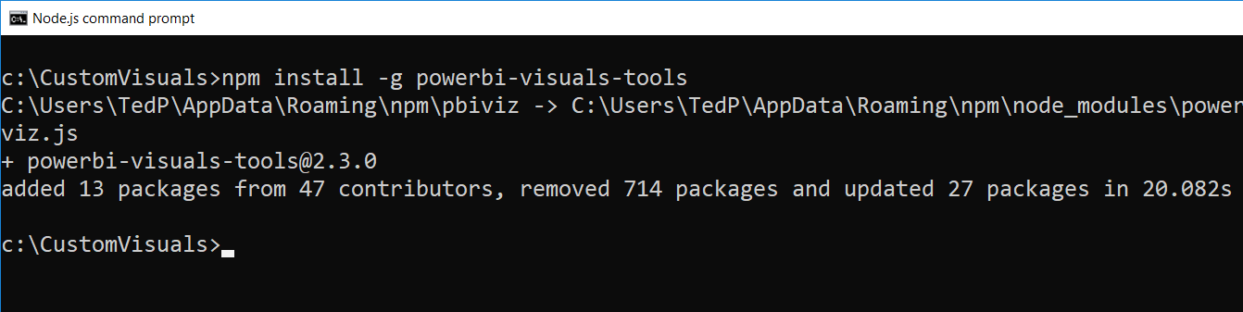
Power BI Visual CLI Tool (PBIVIZ)
What is the Power BI Custom Visual Tool?
Command-line utility for cross-platform dev
Use it with Visual Studio or Visual Studio Code
Requires that you first install node.js
Install by running command from node.js command prompt
npm install -g powerbi-visuals-tools

Slide 8
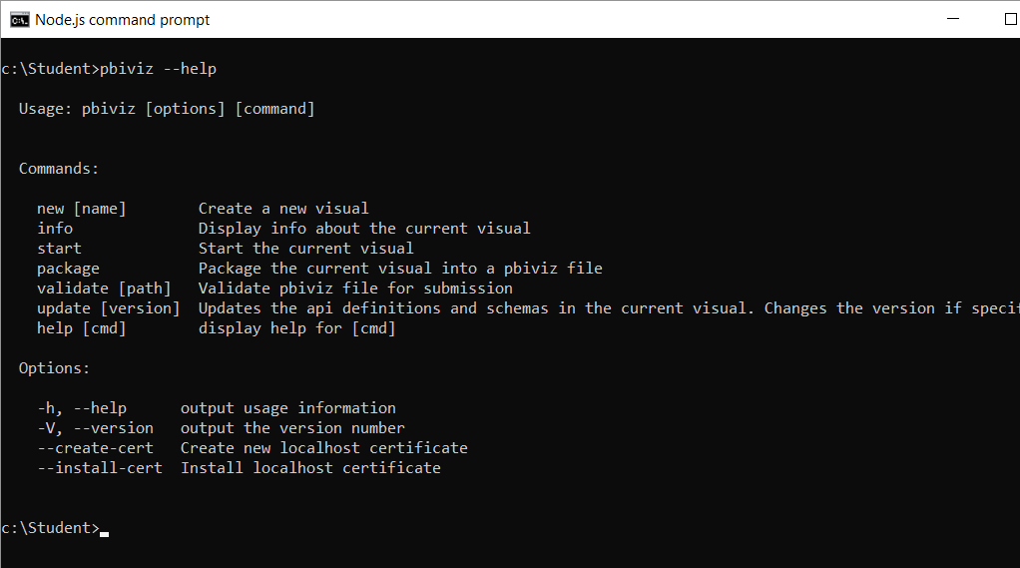
Getting Started with PBIVIZ
PBIVIZ.EXE is a command-line utility
You execute PBIVIZ commands from the NODE.JS command line

Slide 9
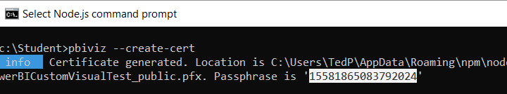
Creating a Certificate for Local Testing
PBIVIZ provide local web server for testing & debugging
Web server runs locally on developer's workstation in Node.js
Makes it possible to test custom visuals in Power BI Service
Custom visual resources served up from https://localhost
Setup requires creating self-signed SSL certificate
SSL certificate created using pbiviz --create-cert command
You must copy a passphrase to properly install the certificate

Slide 10
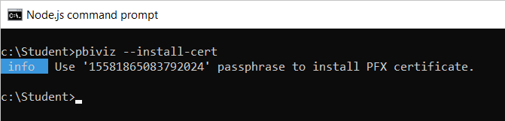
Installing the SSL Certificate
Installing certificate enables SSL through https://localhost
Installing certificate is a one time operation – not once per project
SSL certificate installed using pbiviz --install-cert command
Running --install-cert command starts Certificate Import Wizard

Slide 11
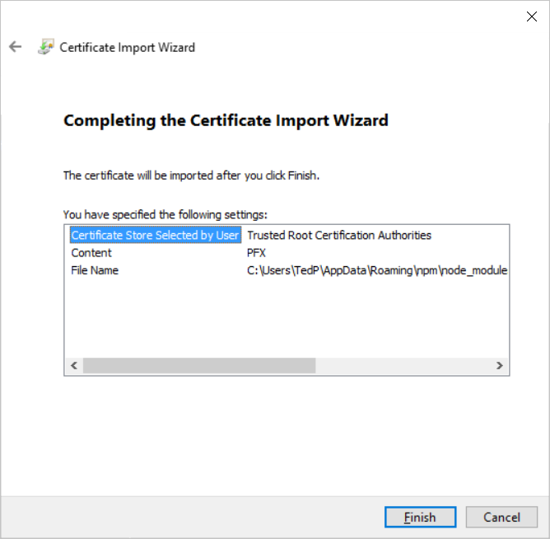
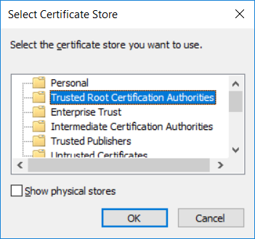
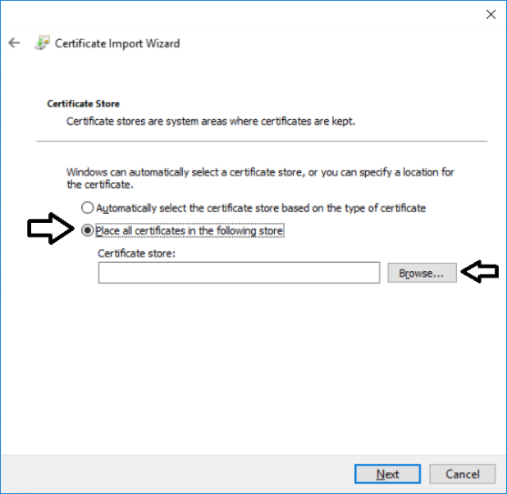
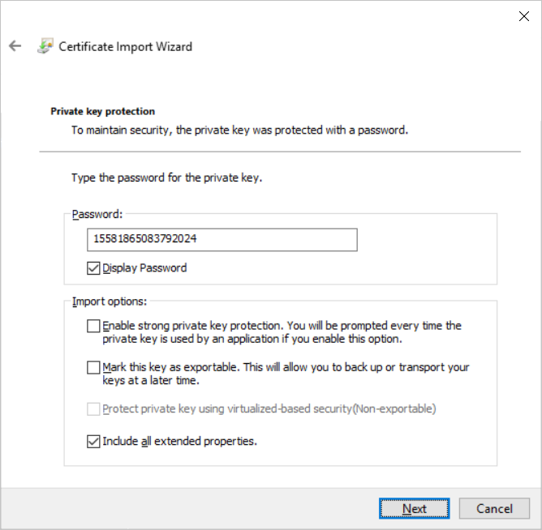
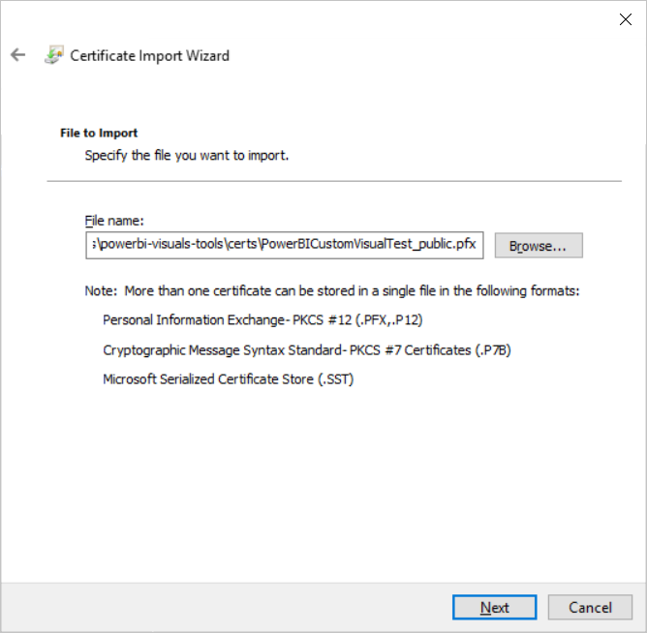
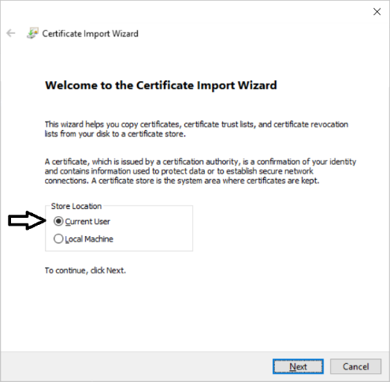
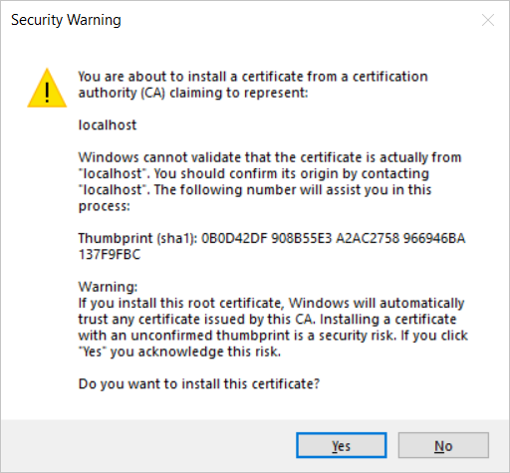
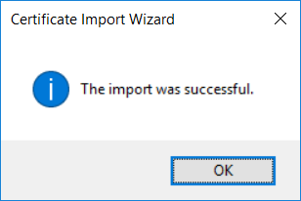
The Certificate Import Wizard
Wizards steps you through process of installing certificate
You enter certificate passphrase as part of installation process

Slide 12
Agenda
Installing the Power BI Developer Tools
Creating Your First Custom Visual
Defining Data Roles and Data Mappings
Extending a Visual with Custom Properties
Migrating to Version 3 of the Power BI Developer Tools

Slide 13
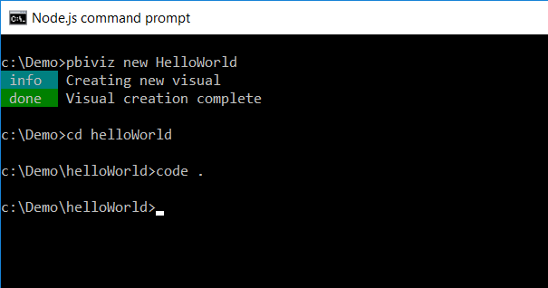
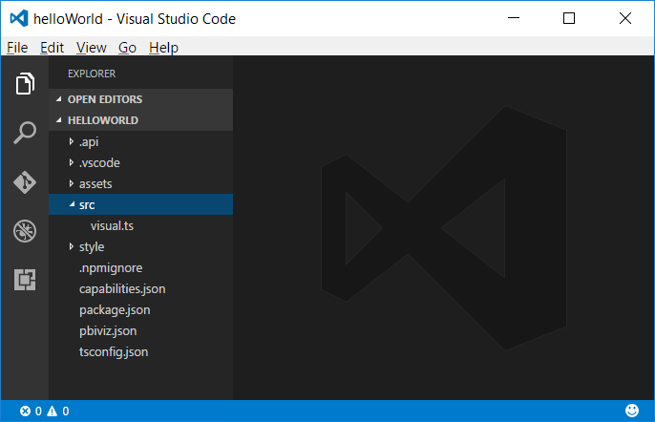
Creating a New Custom Visual Project
Creating a new project
pbiviz new <ProjectName>
Open the Project with Visual Studio Code
code .

Slide 14
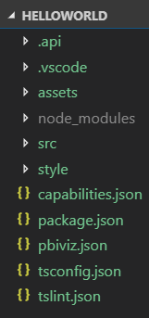
Top-level project files
package.json
Used by npm to manage packages
pbiviz.json
Main manifest file for your custom visual project
capabilities.json
File used to define visual capabilities
tsconfig.json & tslint.json
Typescript compiler settings

Slide 15
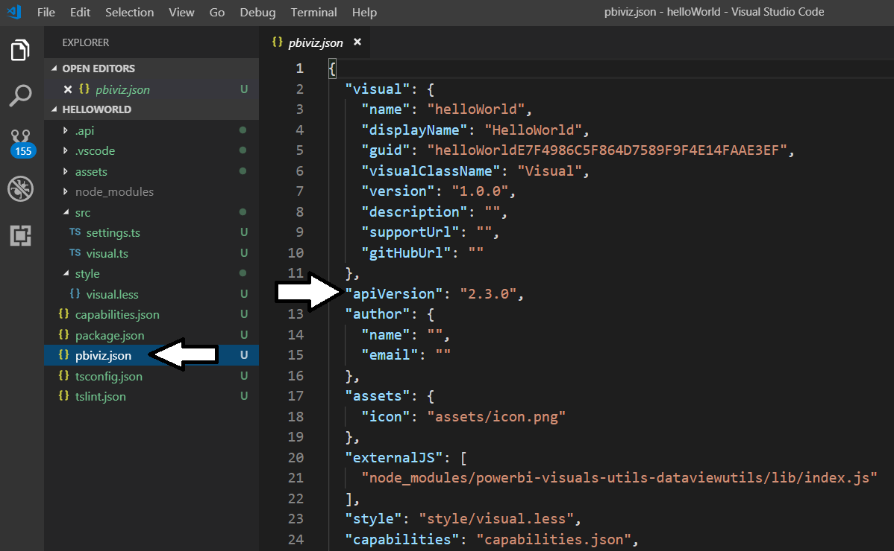
The pbiviz.json File
Acts as top-level manifest file for custom visual project
Indicated which version of the Custom Visual API is used
External JS library files must be referenced in externalJS section

Slide 16
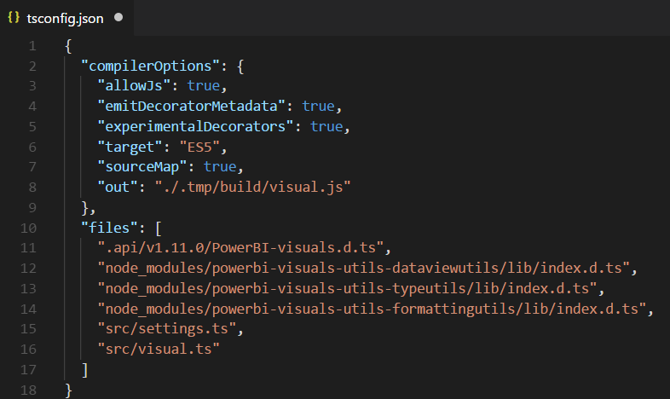
The tsconfig.json File
Used to add references to other TypeScript files
Controls which TypeScript files are passed to TypeScript compiler
No need to reference *.d.ts files in the node_modules/@types folder

Slide 17
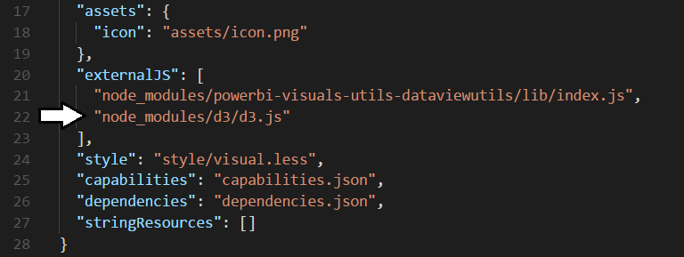
Installing D3 when using PBIVIZ Version 2
Install package for D3 library version 3.x
npm install d3@3 --save-dev
Install package for type definition files version 3
npm install @types/d3@3 --save-dev
Update externalJS section of pbiviz.json

Slide 18
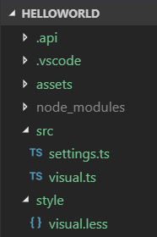
Visual Source Files
visual.ts
visual class definition
settings.ts
helper class to manage visual properties
visual.less
CSS used to style custom visual

Slide 19
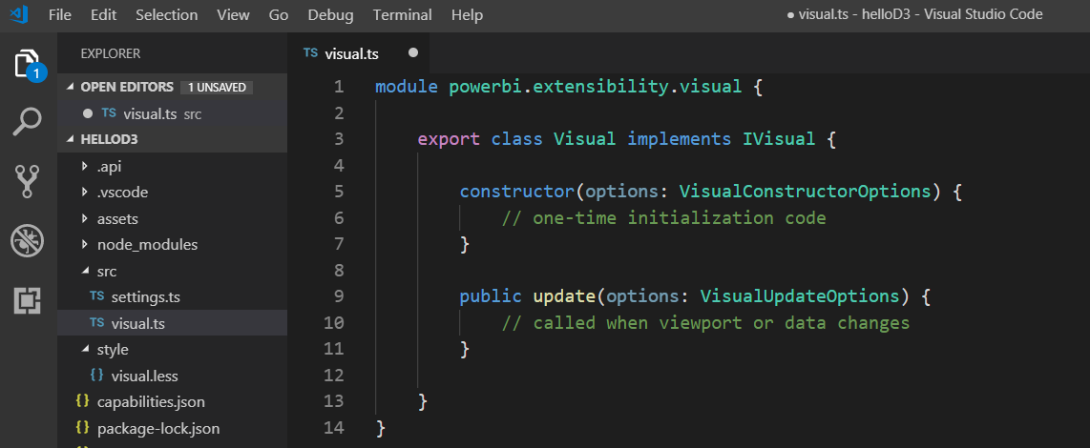
Authoring a Custom Visual Class
Custom visual is a class that implements IVisual
Class must be defined in powerbi.extensibility.visual namespace
Minimum visual class must provide update method
Parameterized constructor used to create visual elements

Slide 20
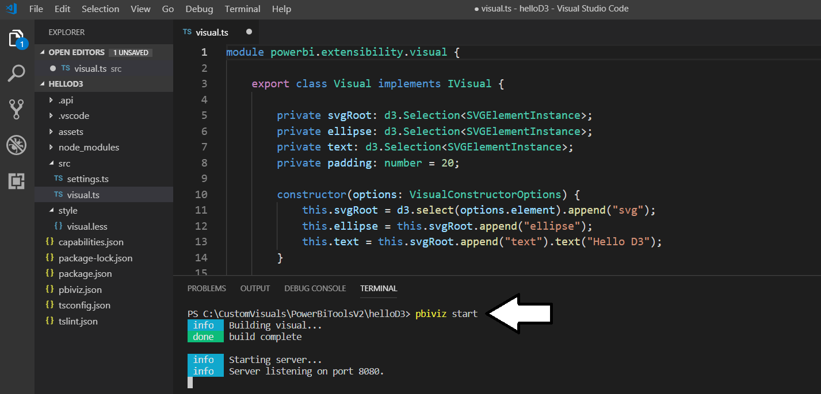
Running a Custom Visual Project
Visual projects run & tested using pbiviz start command
Run pbiviz start from Visual Studio Code from Integrated console
Command starts local debugging session in node.js

Slide 21
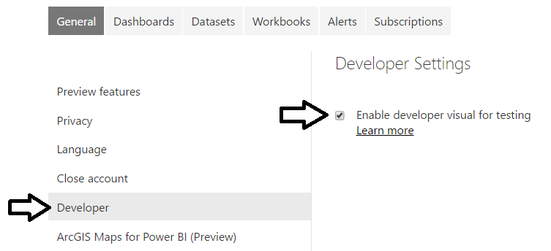
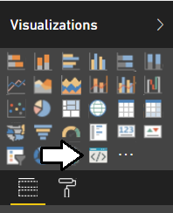
The Developer Visual
Must be enabled on Developer Settings page
Provides new visual for testing and debugging custom visuals

Slide 22
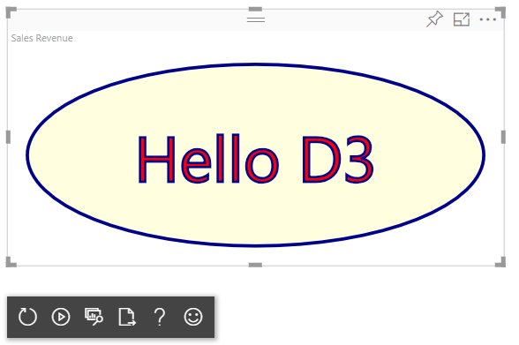
Working with the Developer Visual
Developer visual loads custom visual from node.js
Makes it possible to test custom visual inside Power BI Service
Developer visual provides toolbar with development utilities

Slide 23
Agenda
Installing the Power BI Developer Tools
Creating Your First Custom Visual
Defining Data Roles and Data Mappings
Extending a Visual with Custom Properties
Migrating to Version 3 of the Power BI Developer Tools

Slide 24
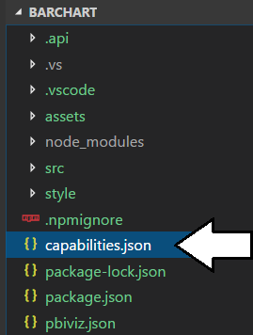
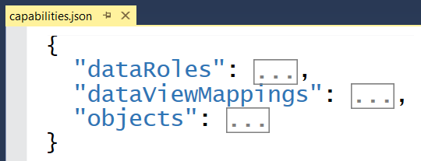
Visual Capabilities
Visual capabilities defined inside capabilities.json
dataRoles defines the field wells displayed on Fields pane
dataViewMappings defines the type of DataView used by visual
objects defines custom properties for visual

Slide 25
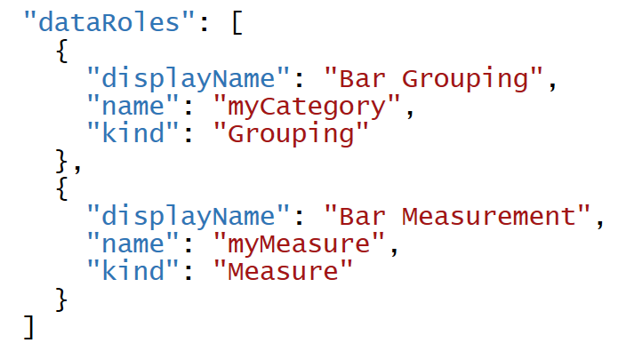
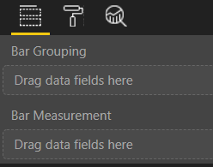
Data Roles
DataRoles define how fields are associated with visual
Each dataRole is display as field well in the Field pane
dataRoles can be defined with conditions and data mappings

Slide 26
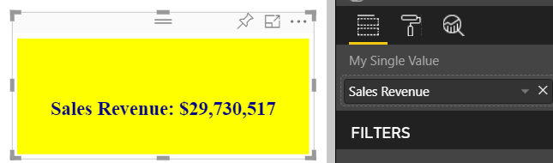
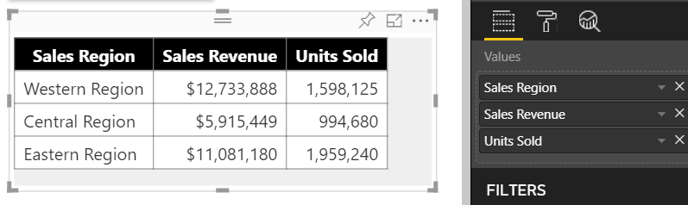
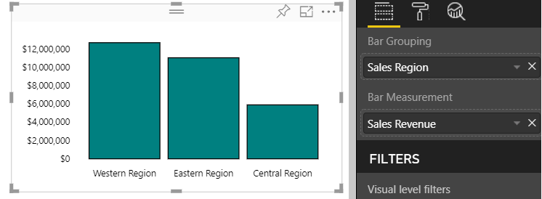
Data Mapping Modes
Power BI visual API provides several mapping modes
Single
Table
Categorical
Matrix
Tree
Single Mapping
Table Mapping
Categorical Mapping

Slide 27
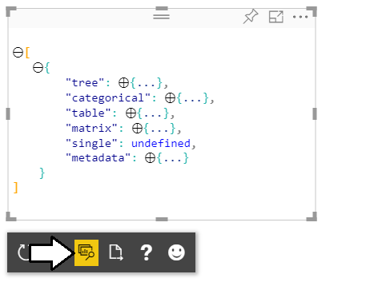
Developer Visual DataView
Developer visual supports DataView mode
Allows you to see and explore data mapping
Allows you to see metadata for custom properties

Slide 28
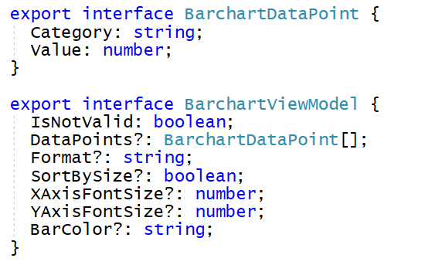
Designing with View Model
Best practice involves creating view model for each visual
View model defines data required for rendering
createViewModel method gets data to generate view model
update method calls createViewModel to get view model

Slide 29
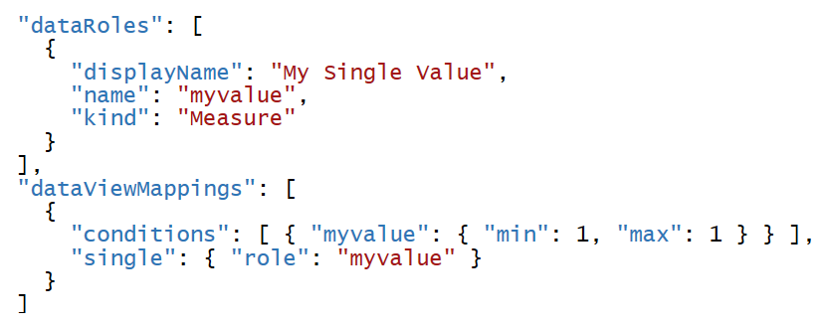
Single Mapping Example: oneBigNumber
dataRole can use dataViewMapping mode of single
For visuals like Card which only display single value
Condition can define that a dataRole requires exactly one measure

Slide 30
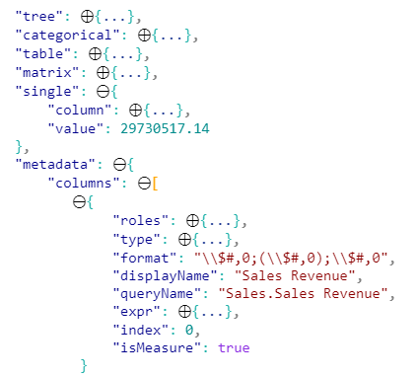
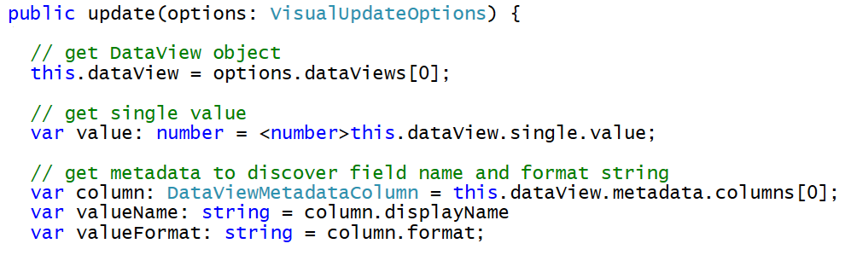
Programming in Single Mapping Mode
Single mapping easy to access through visuals API
DataView object provides single.value property
value property defined as PrimativeValue { bool | number | string }
PrimativeValue must be explicitly cast
Other measure properties available through column metadata

Slide 31
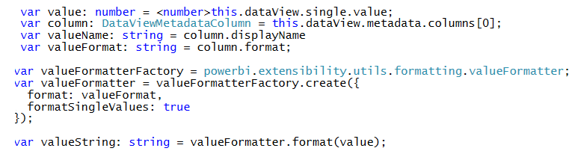
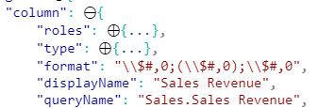
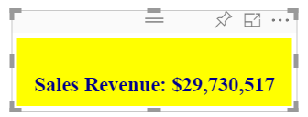
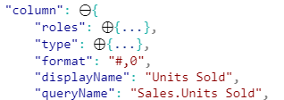
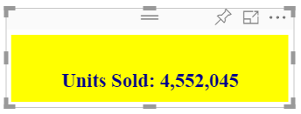
Using the Power BI Formatting Utilities
Used to format values using Power BI formatting strings
Requires installing powerbi-visuals-utils-formattingutils package

Slide 32
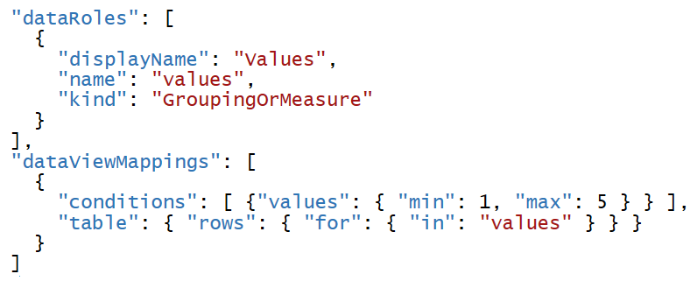
Table Mapping Example: Snazzy Table
dataRole can use dataViewMapping mode of table
For visuals which display rows & columns for ordered set of fields
condition can define number of fields that can be added

Slide 33


Programming in Table Mapping Mode
Table mapping data accessible through visuals API
DataView object provides table property
table property provides columns property and rows property

Slide 34

Categorical Mapping Example: Barchart
dataRole can use dataViewMapping mode of categorical
This is the most common type of data mapping
For visuals which divide data into groups for analysis
Groups defined as columns and values defined as measures

Slide 35
Agenda
Installing the Power BI Developer Tools
Creating Your First Custom Visual
Defining Data Roles and Data Mappings
Extending a Visual with Custom Properties
Migrating to Version 3 of the Power BI Developer Tools

Slide 36


Extending Visuals with Custom Properties
Custom properties defined using objects
You can define one or more objects in capabilities.json
Each object defined with name, display name and properties
object properties automatically persistent inside visual metadata
properties can be seen and modified by user in Format pane
Custom properties require extra code to initialize Format pane

Slide 37

DataViewObjectParser and VisualSettings
Power BI visual utilities provide DataViewObjectParser
Abstracts away tricky code to initialize and read property values

Slide 38
Mapping Object Properties to VisualSettings
VisualSettings class must map to named objectnamed
VisualSetting class contains named field that maps to object name
Named field based on custom class with mapped properties
Object & property names must match what's in capabilities.json

Slide 39

Initializing Objects in the Format Pane
Visual must initialize properties in Format pane
Visual must implement enumerateObjectInstances
VisualSettings makes this relatively easy
Extra code required to make property appear as spinner

Slide 40


Retrieving Property Values
Property values persisted into visual metadata
Properties not persisted white they still retain default values
Property values retrieved using VisualSettings object

Slide 41
Agenda
Installing the Power BI Developer Tools
Creating Your First Custom Visual
Defining Data Roles and Data Mappings
Extending a Visual with Custom Properties
Migrating to Version 3 of the Power BI Developer Tools

Slide 42

Tools v2
Power BI API added to your project
Power BI API files added to project
You install packages for utilities
Add externalJS entries for JavaScript libraries required on page

Slide 43
EcmaScript2015 Modules and D3 version 5
ECMAScript 2015 add modules to JavaScript
TypeScript builds on the concept
Each file defines it own module
Modules execute in their own scope not at global scope
Code in module not visible to other modules by default
Classes and function must be exported to use across modules
Modules must import types from other modules
relationships between modules defined using imports and exports

Slide 44



Dynamic Module Loading
Webpack controls dynamic module loading
Your project just references app.ts
Compiler dynamically determines other files to include

Slide 45
WebPack
WebPack serves as a bundling utility
Bundles many js/ts files into a single file
Can handle dynamic module loading
Provides a dev server for testing and debugging
When using Webpack version 4 or later
Install packages for webpack and webpack-cli
npm install webpack webpack-cli --save-dev

Slide 46
Webpack Loaders
Loaders do two things
Identify which file or files should be transformed
Transform files and ad them to dependency graph
Example loaders
awesome-typescript-loader
style-loader
css-loader
url-loader

Slide 47
Summary
Installing the Power BI Developer Tools
Creating Your First Custom Visual
Defining Data Roles and Data Mappings
Extending a Visual with Custom Properties
Migrating to Version 3 of the Power BI Developer Tools

